Slide 1

The application of GL27 in the authorisation of antimicrobials in the EU
Presented by Zoltan Kunsagi on 17 November 2020
Scientific Administrator, Veterinary Risk and Surveillance Department

Slide 2
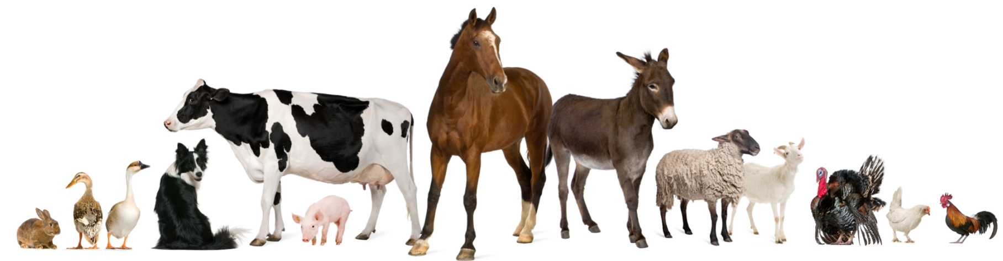
Disclaimer
These slides have been provided for training purposes only. The presenter has made every attempt to ensure that they are consistent with relevant VICH guidelines.
As always, the original Guideline(s) should be used as the primary source of information for working with regulators.

Slide 3
Authorisation of antimicrobials in the EU
Overall goal:
Demonstrate quality, safety and efficacy of the veterinary medicinal product (as for all veterinary medicinal products)
Specific goal:
Minimise potential for antimicrobial resistance and ensure antimicrobials retain their effectiveness for treating microbial infections in humans - particularly relevant for food-producing animals

Slide 4

Data requirements
For veterinary medicines for food-producing animals:
  establishment of maximum residue levels (MRLs); includes data for establishment of a microbiological ADI according to VICH GL36
  Data according to VICH GL27 for new products
  MIC and PK/PD data for use in efficacy assessment

Slide 5

VICH GL27
Guidance on pre-approval information for registration of new veterinary medicinal products for food-producing animals with respect to antimicrobial resistance.
This guideline focuses on the potential for antimicrobial drugs to lead to development of resistant organisms in target animals, which could be transferred to consumers via food.
This guideline outlines the types of studies and data, which are recommended to characterise the potential resistance development as it might occur in the food-producing animal under the proposed conditions of use of the product.

Slide 6
VICH GL27 – Data recommendations (1/4)
1. Basic information
1.1 Antimicrobial class
1.2 Mechanism and type of antimicrobial action
1.3 Antimicrobial spectrum of activity
1.3.1 General data
1.3.2 MICs of target animal pathogens (as per product label claim)
More detailed requirements for these data may be provided in the GLs on Efficacy for the jurisdiction (e.g. sampling requirements, methodology for AST).
1.3.3 MICs of food-borne pathogens and commensal organisms
Data: industry collections, national screening programmes and regional monitoring e.g. NARMS, EFSA/ECDC. Supplementary proprietary studies: in the application (rather than AM class), using a smaller number of isolates.

Slide 7
VICH GL27 – Data recommendations (2/4)
1. Basic information (cont.)
1.4 Antimicrobial resistance mechanisms and genetics
Published studies. Studies with molecular methods to identify specific resistance genes.
1.5 Occurrence and rate of transfer of antimicrobial resistance genes
Rarely been provided and up-to-date guidance should be followed on study methodology.
1.6 Occurrence of cross-resistance
1.7 Occurrence of co-resistance
1.6 and 1.7: published literature. Proprietary studies: evidence of cross/co-resistance based on phenotypic MIC studies.
1.8 Pharmacokinetic data
Human Safety and Efficacy parts of the dossier, and the MRL dossier.

Slide 8
VICH GL27 – Data recommendations (3/4)
2. Additional information
2.1 In vitro mutation frequency studies
Proprietary studies + up-to-date advice on study design
2.2 Antimicrobial agent activity in intestinal tract
Laboratory animal ADME (radiolabelled) studies in the Residues or MRL dossier
2.3 Other animal studies
In vivo studies investigating resistance in commensal bacteria following treatment is complex
2.4 Supporting information

Slide 9
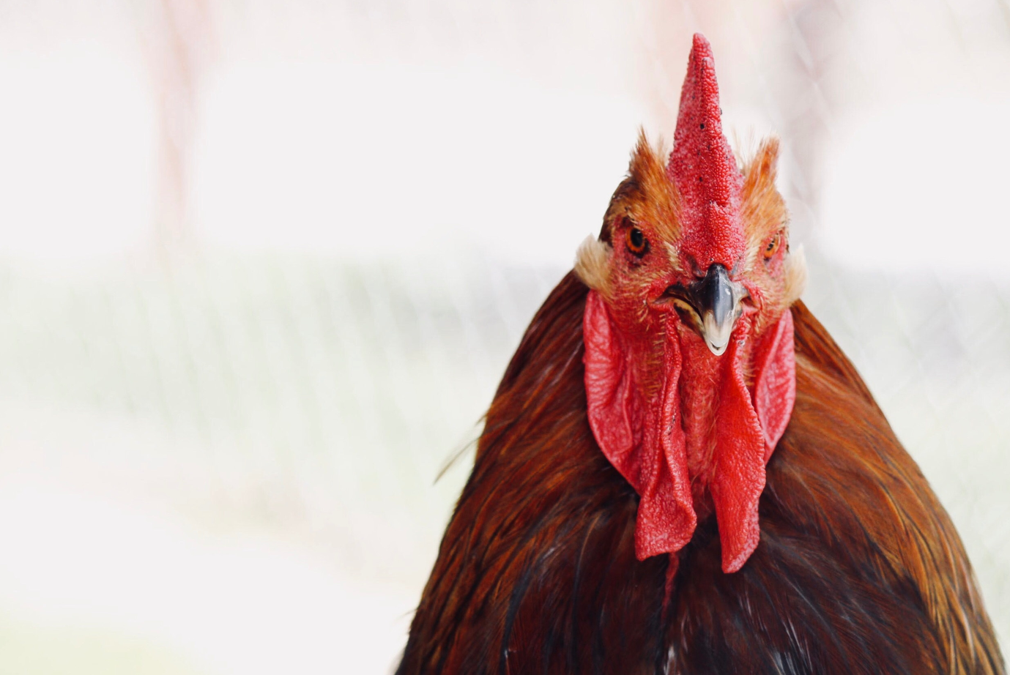
VICH GL27 – Data recommendations (4/4)
3. Discussion
The potential for the use of the product to select for AMR bacteria of human health concern should be characterised.
This should take account of the conditions of use of the VMP: target species, dosing regimen, group/individual treatment – all factors that will affect the exposure of relevant PH organisms to the AM.

Slide 10

Further guidance on assessment of resistance potential
  When evaluating the safety of antimicrobial products for use in food-producing animals, regulatory authorities should consider the potential for such products to select for resistant bacteria of human health concern.
  not only 1) Target animal pathogens
  But also 2) Food-borne pathogens
  3) Commensal organisms are important for evaluating.
  Next presentation shows the EMA/CVMP approach: Draft CVMP guideline on the assessment of the risk to public health from antimicrobial resistance due to the use of an antimicrobial veterinary medicinal product in food-producing animals

Slide 11
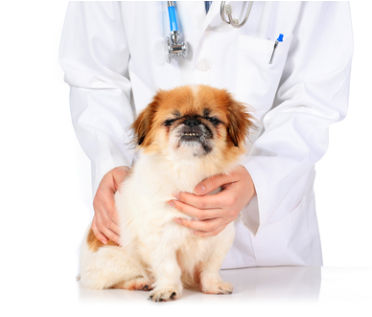
Ensure conditions of use are appropriate and advice to veterinarians is clear
In addition to addressing the potential for resistance development and transfer we need to ensure appropriate use of the product:
all use will select for antimicrobial resistance
unnecessary/inadequate use will prolong the time period for which the substance remains active

Slide 12
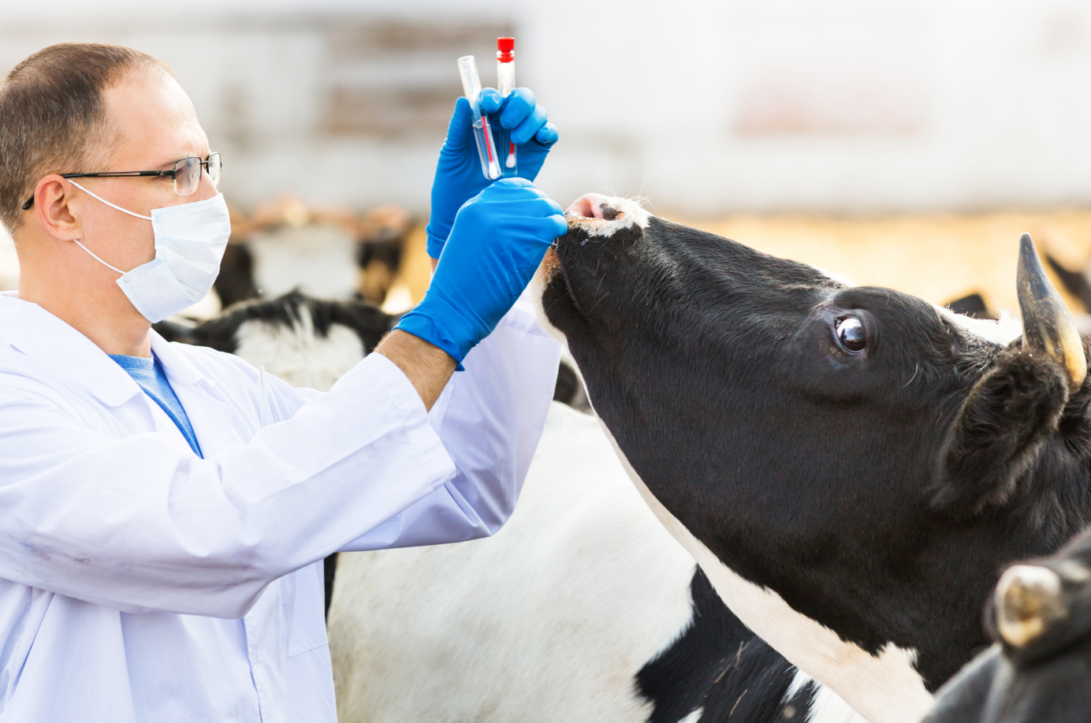
Summary
Evaluate potential for antimicrobial resistance development (VICH GL27)
Assessment of risk to public health of antimicrobial resistance resulting from proposed use (OIE/Codex Alimentarius/FDA/CVMP guidance)
Ensure conditions of use are appropriate (indications, dosing regimen…)
Ensure product information is clear and emphasises principles of prudent use

Slide 13

Further information
Official address Domenico Scarlattilaan 6 ● 1083 HS Amsterdam ● The Netherlands
Address for visits and deliveries Refer to www.ema.europa.eu/how-to-find-us
Send us a question Go to www.ema.europa.eu/contact Telephone +31 (0)88 781 6000
Follow us on @EMA_News
Notes:
Note: This slide is OPTIONAL. It uses the 'Closing slide' layout. Delete if not needed.

